Slide 1
COMPUTER VISION
FINAL PROJECT
Enhancing Seam Carving with Semantic Segmentation
A Practical Guide to Smarter Content-Aware Image Resizing
By Malik Kolawole Lanlokun (2120246036)

Slide 2
TABLE OF CONTENTS
01
02
03
04
INTRODUCTION
OBJECTIVE
Goals of the Enhanced Seam Carving Approach
Challenges in Traditional Methods
METHODOLOGY
RESULTS & CONCLUSION
Steps for Implementing the Optimized Algorithm
Comparison of Original and Processed Images

Slide 3
01
INTRODUCTION
Why Optimize Seam Carving?

Slide 4
INTRODUCTION
Traditional seam carving uses energy maps to identify important areas but lacks context awareness, often distorting key elements. Integrating semantic segmentation preserves context, ensuring more accurate and visually appealing resizing.

Slide 5
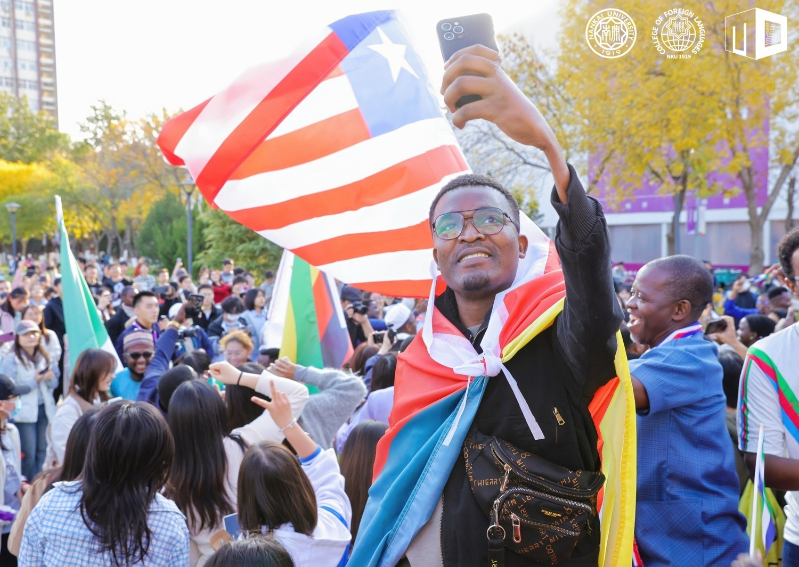
THE PROBLEM

Slide 6
SOLUTION
Combine seam carving with semantic segmentation to prioritize preserving important objects and regions in the image.

Slide 7
What is Semantic Segmentation?
A deep learning technique to label each pixel in an image as belonging to a specific class (e.g., person, car, background).

Slide 8

Goal
Preserve essential objects using semantic segmentation.
Improve seam carving efficiency.

Slide 9
Methodology
01
03
02
04
Energy Map Calculation
Energy Map Enhancement
Sobel operator for edge detection to compute the energy map.
Integrate segmentation results to modify the energy map for better context-aware resizing.
Semantic Segmentation
Seam Carving
Apply seam carving algorithm, removing seams based on the enhanced energy map.
DeepLabV3 model to generate segmentation masks of important regions.

Slide 10
IMPLEMENTATION
Step 1
Step 4
Load the original image in full resolution
Enhance the energy map with segmentation mask data.
Step 2
Step 5
Perform seam carving to resize the image.
Compute energy map using Sobel filters.
Step 3
Step 6
Output Resized Image
Use DeepLabV3 (PyTorch) to create a segmentation mask.

Slide 11
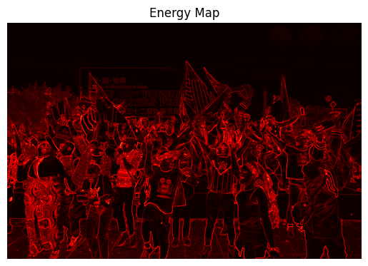
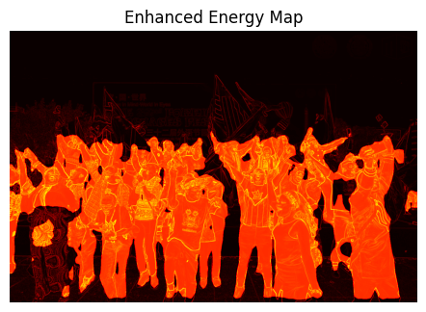
Enhancing the Energy Map
Eenhanced = EOriginal + α⋅Msegmentation
Combine segmentation mask with the energy map.
Boost weights in regions containing critical objects.

Slide 12
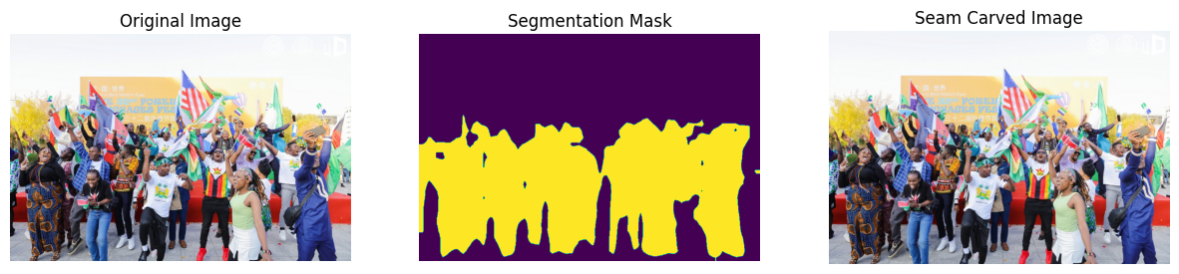
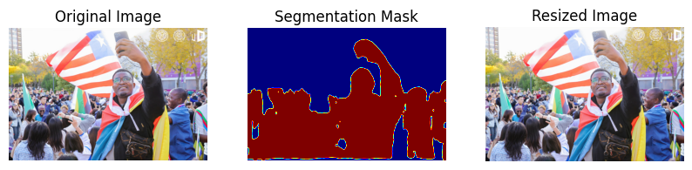
RESULTS

Slide 13
RESULTS
Observation
Efficiency
Enhanced seam carving outperforms traditional methods in content preservation.
Seam carving with semantic segmentation produces more natural and visually appealing resized images.

Slide 14

LIMITATIONS
The enhanced seam carving algorithm, while effective for images with prominent humans, struggles with images containing fewer or less prominent semantically significant objects

Slide 15
CONCLUSIONS
Integrating semantic segmentation into seam carving enhances context awareness, ensuring that important visual elements are better preserved. This approach reduces distortion in key areas, leading to more accurate and visually appealing image resizing.

Slide 16
FUTURE WORK
Future work could focus on using advanced segmentation models, combining seam carving with object detection, and optimizing for faster, real-time image resizing.

Slide 17
REFERENCES
References
Shai Avidan and Ariel Shamir, Seam Carving for Content-Aware Image Resizing.
Chen et al., DeepLab: Semantic Image Segmentation with Deep Convolutional Nets.

Slide 18
THANKS!
Do you have any questions?
mlanlokun@nankai.edu.cn

